Slide 1


Slide 2
What do you know about python?
It is a high level programming language and Object Oriented scripting language.
It doesn’t not have format specifiers unlike C language which do need them.
Indentation is very important in python.
It is a interpreting language.
It has vast collection of libraries and packages.

Slide 3
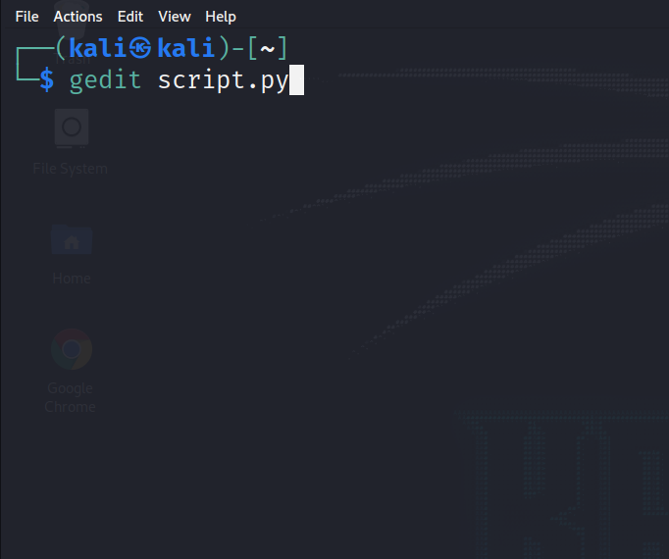
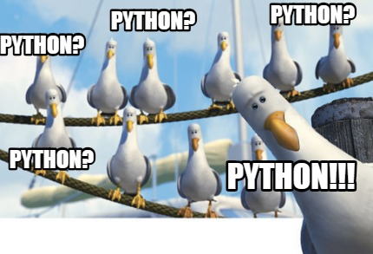
How to start coding in python?

Slide 4
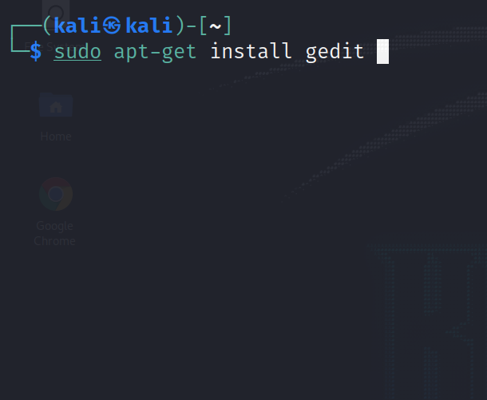
Installing
gedit

Slide 5
Beginning to code in python

Slide 6
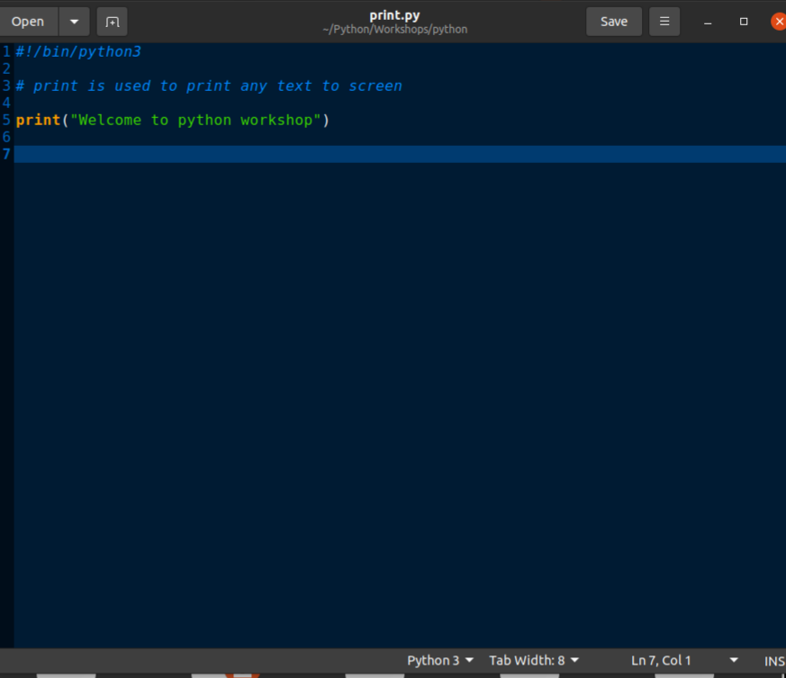
Print Statement
Notes:
Figlet printing

Slide 7
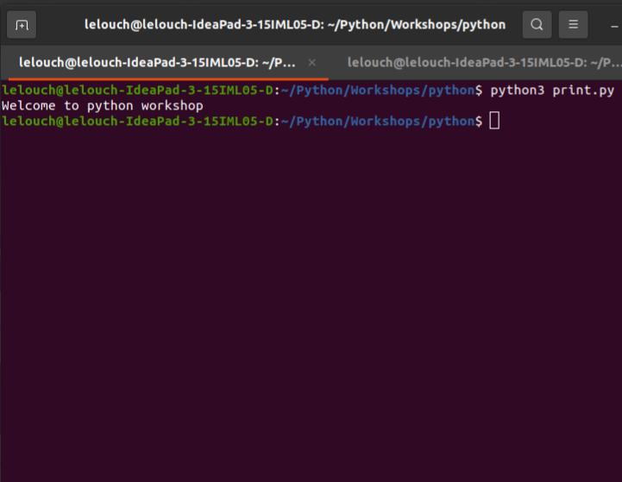
Output
Statement

Slide 8
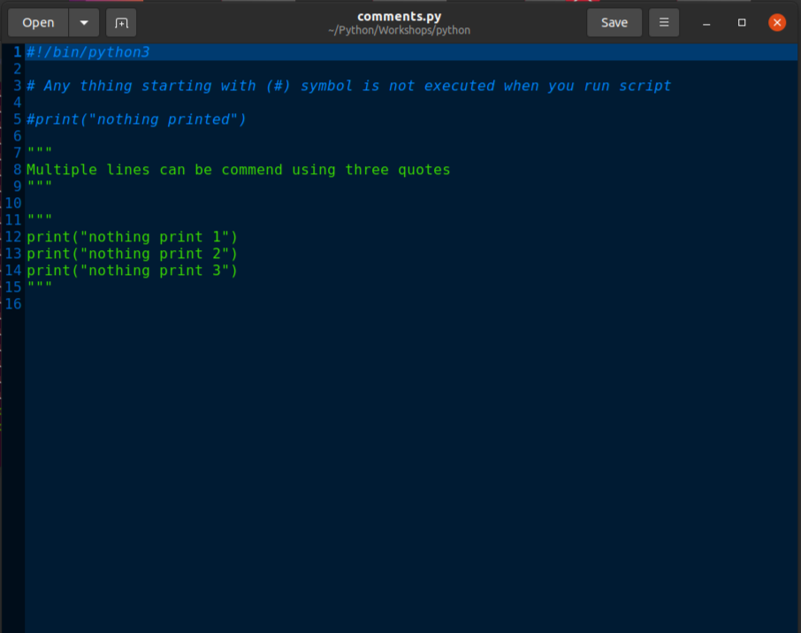
How to Comment

Slide 9
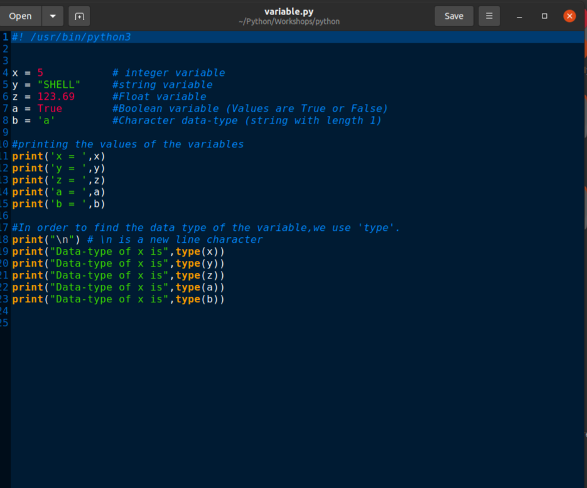
Variables

Slide 10
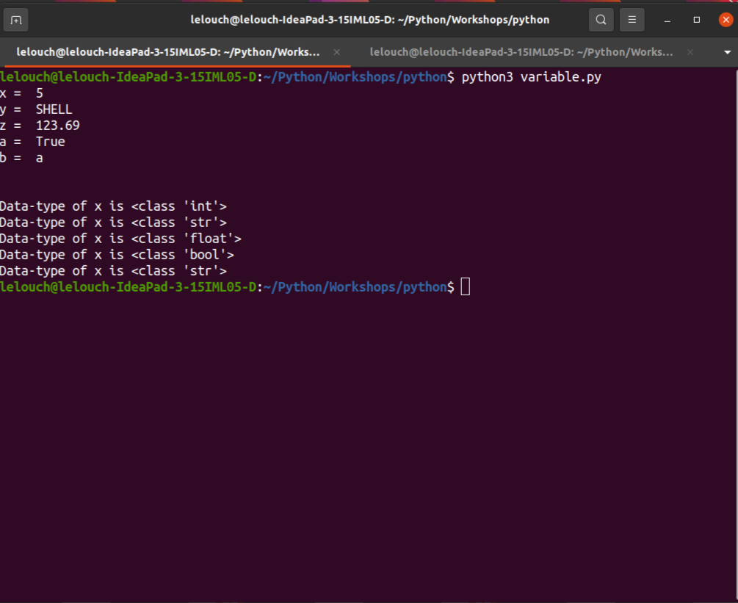
Variable output

Slide 11
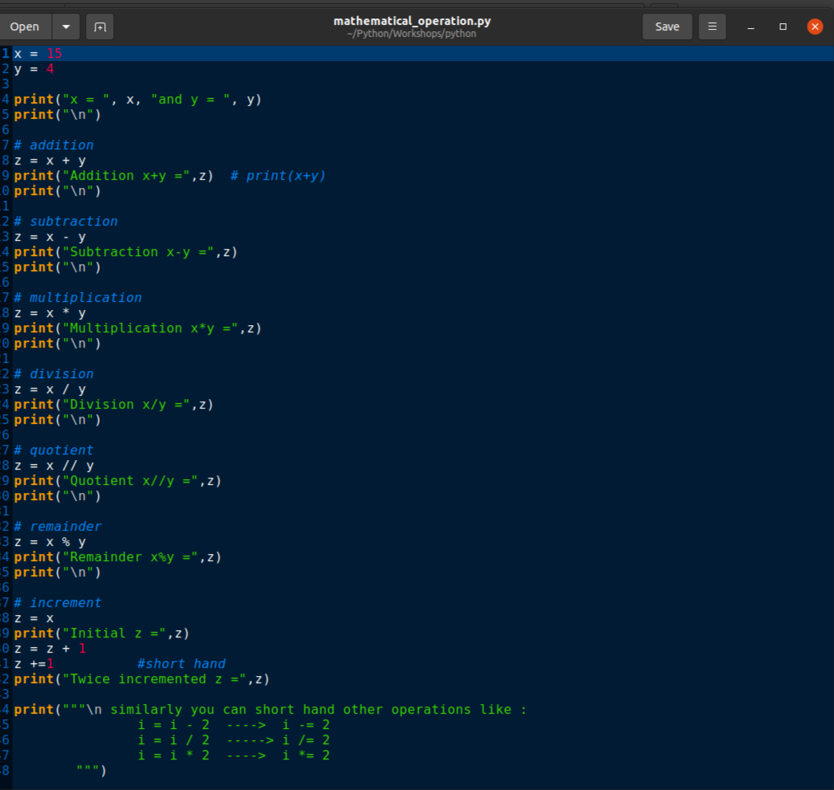
Operators

Slide 12
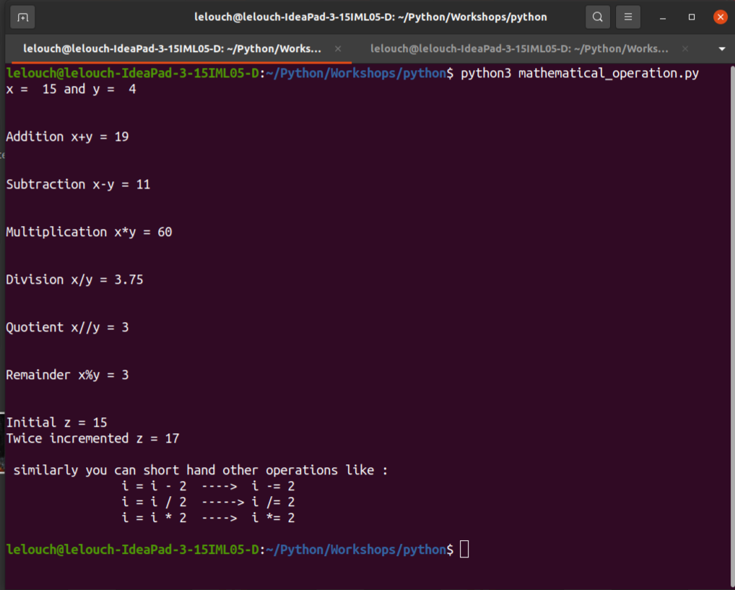
Operators

Slide 13
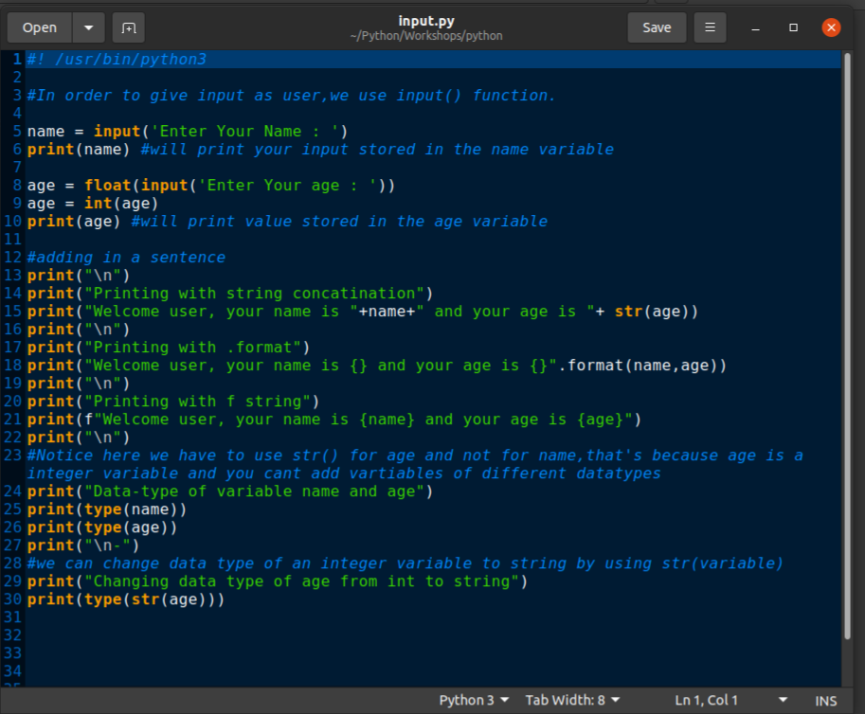
Input

Slide 14
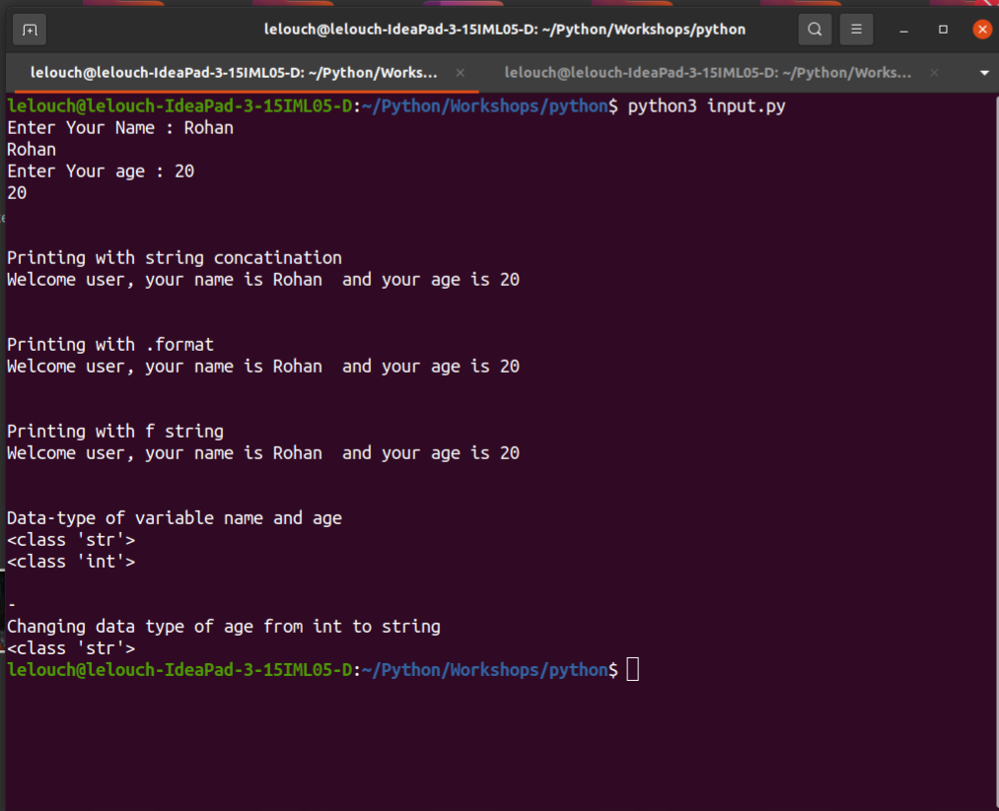
Input output
Statements

Slide 15
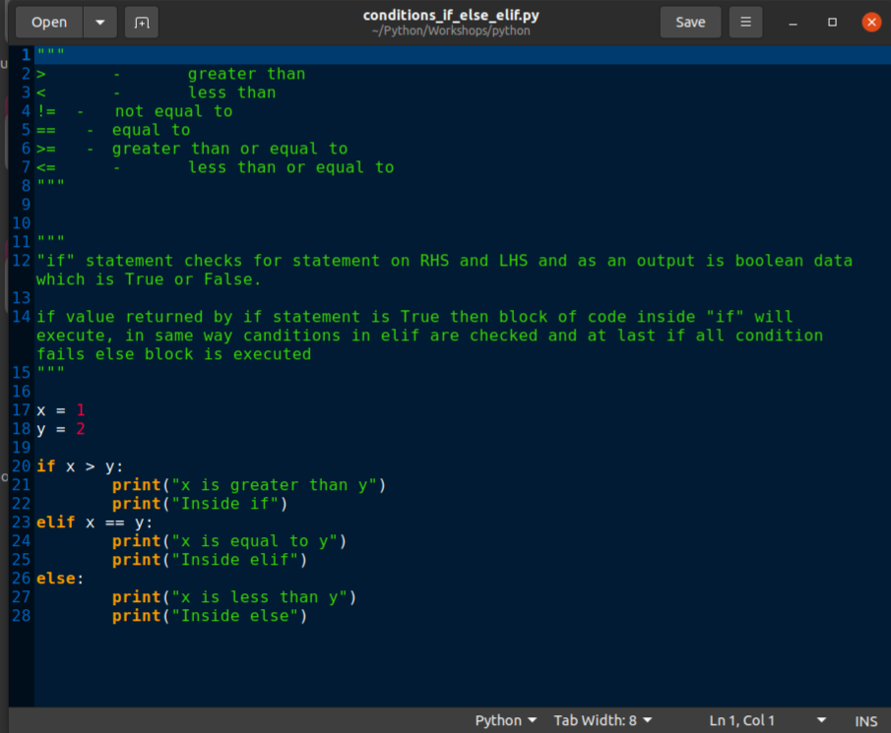
If else

Slide 16
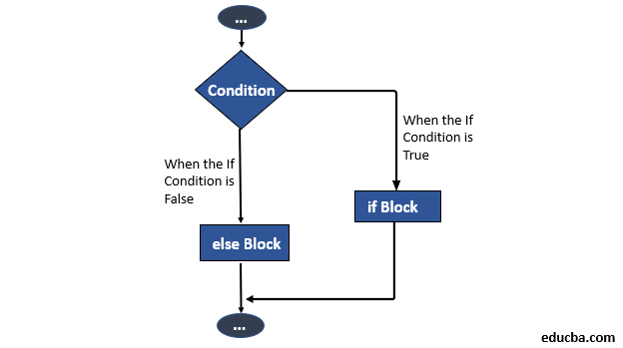

Slide 17
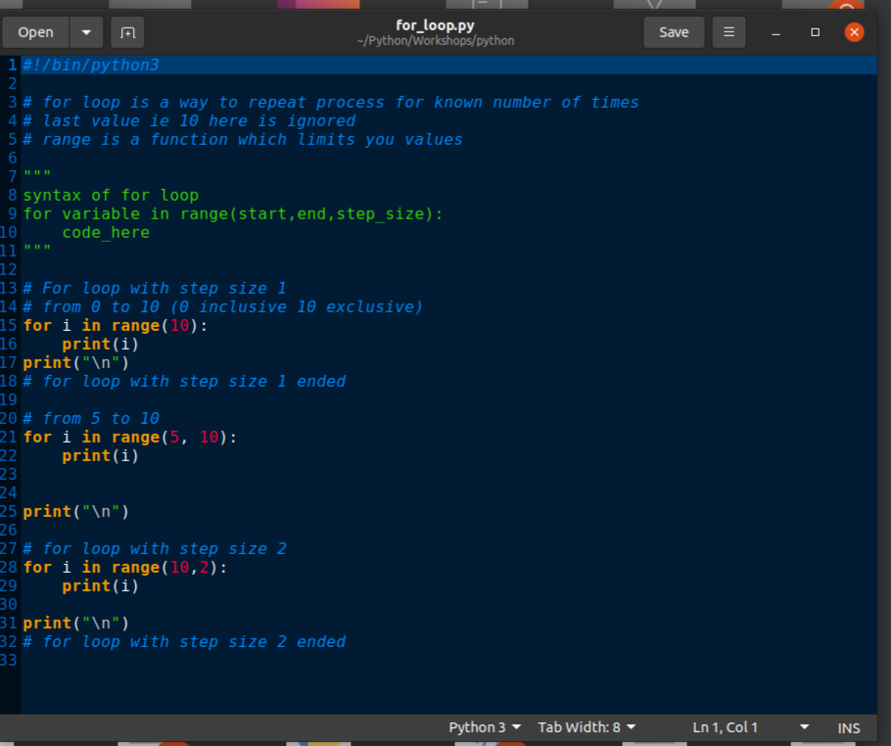
For loop

Slide 18
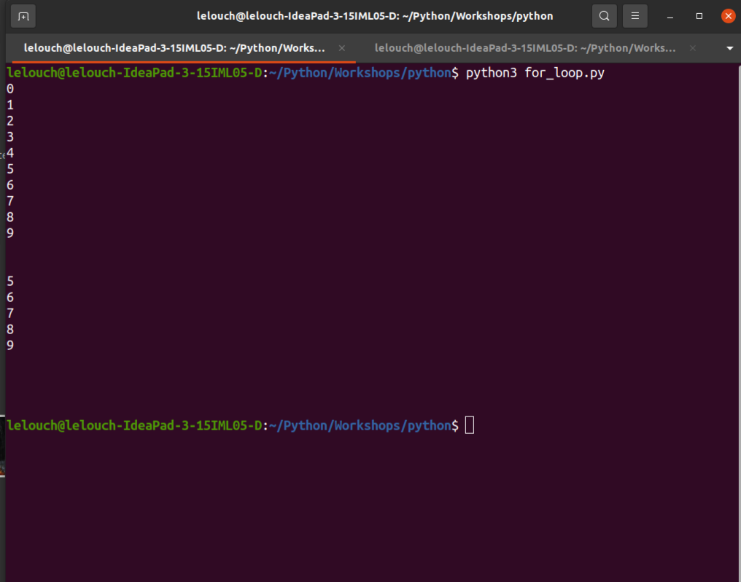
Output

Slide 19
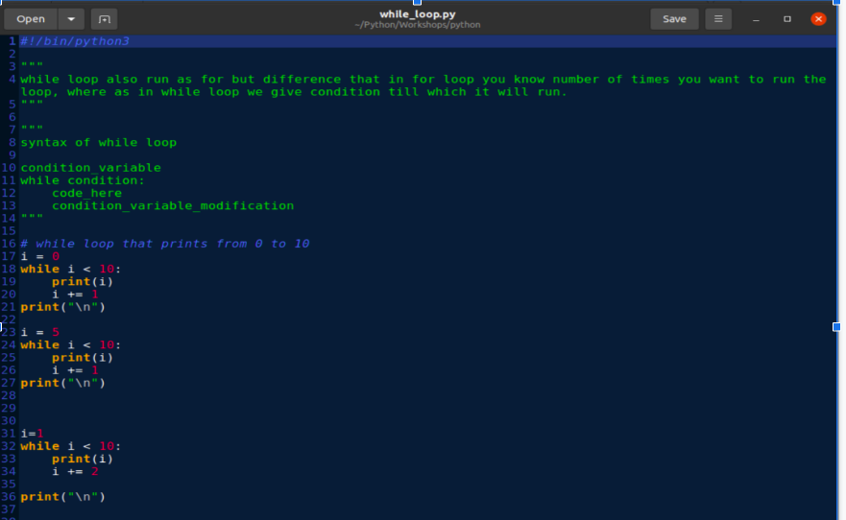
While loop

Slide 20
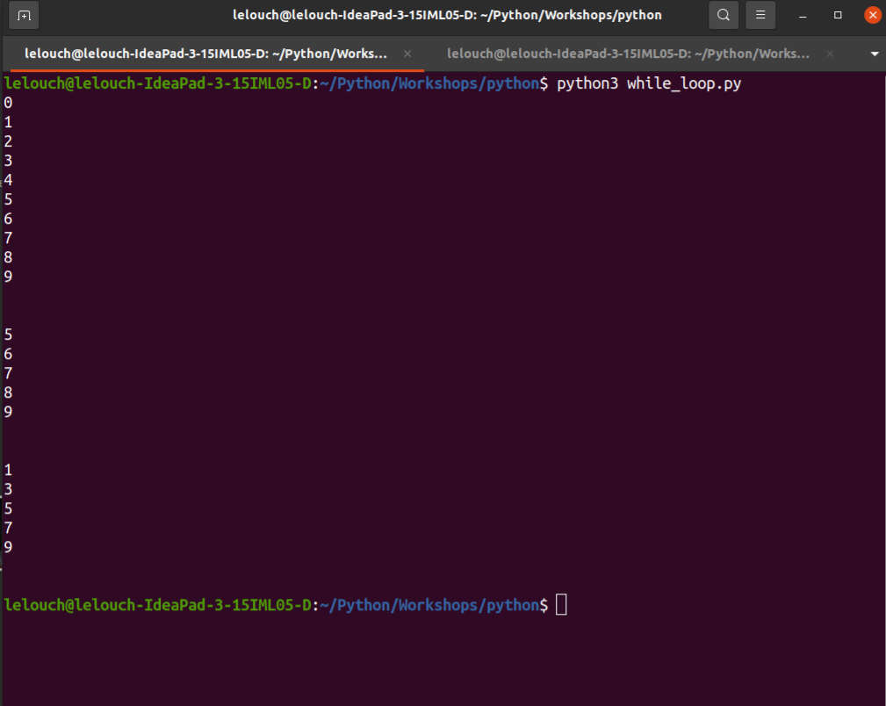
While output

Slide 21
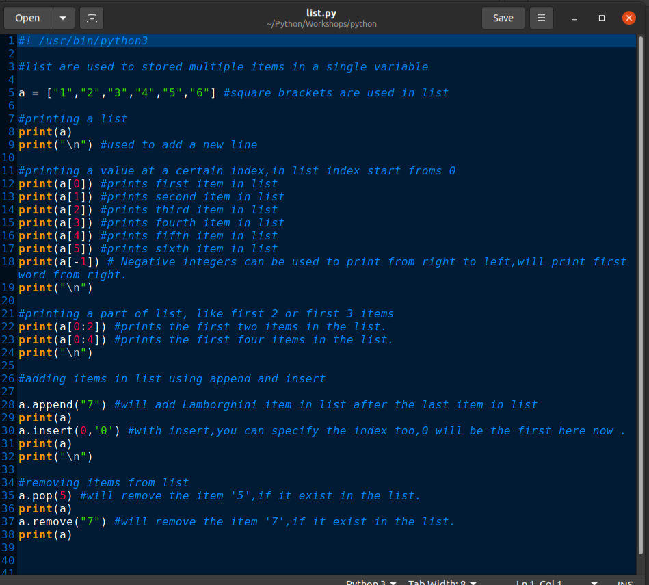
List

Slide 22
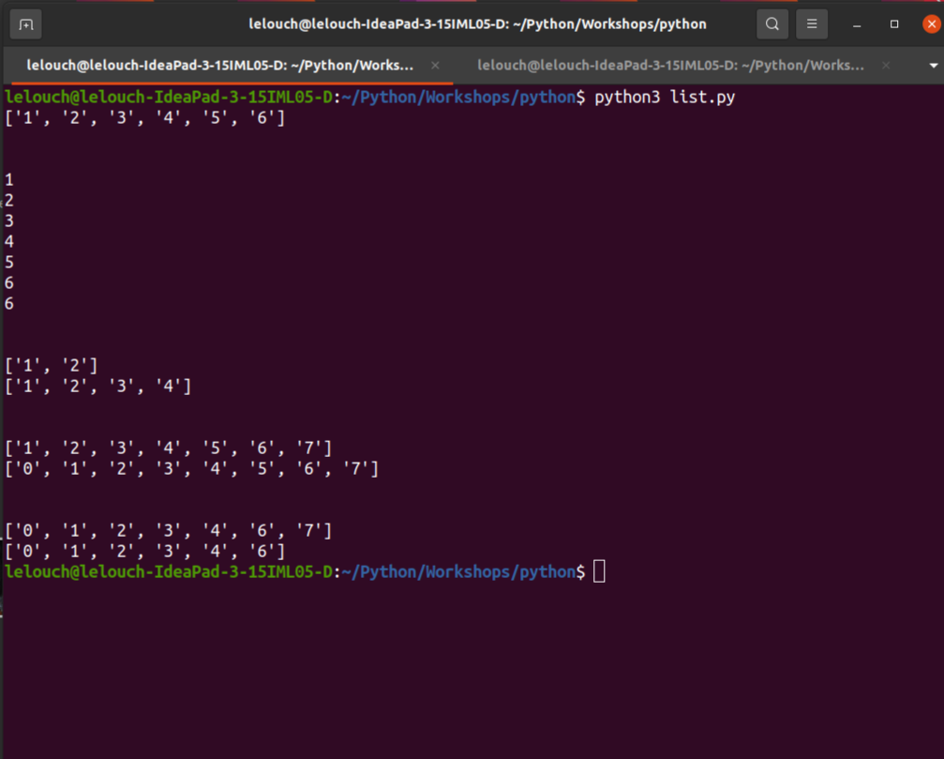
Output

Slide 23
What Next
Try-except , Recursion
Keylogger

